Slide 1
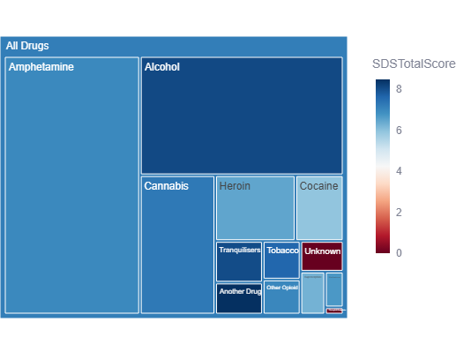
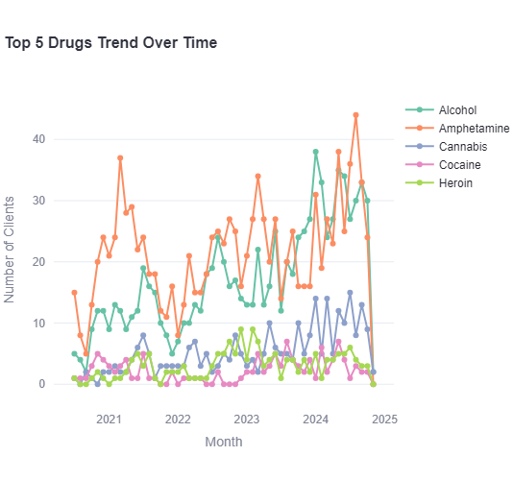
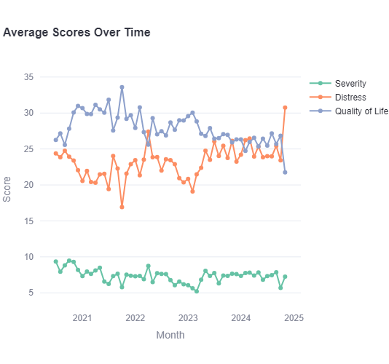
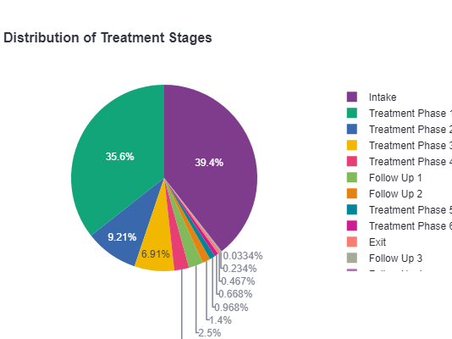
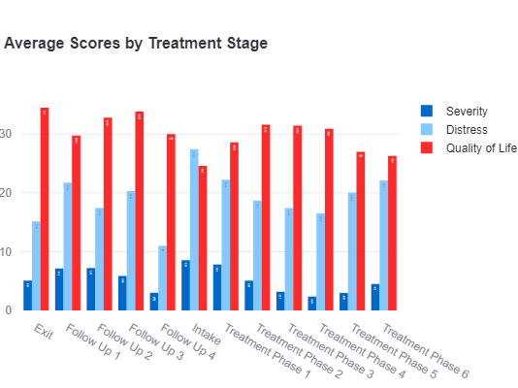
OVERVIEW STATISTICS
KEY METRICS
Total Clients: 1166
Treatment Episodes: 1500
Active Cases (Treatment Phases): 642
Avg Episodes/Client: 1.3
LIVE DASHBOARD
odyssey-dashboard.streamlit.app
GITHUB
https://github.com/GinaPhan/OdysseyIntern
01
Notes:
Top 5 Drugs Trend Over Time: Alcohol and Amphetamine are the most prevalent drugs among clients, necessitate more resources and targeted interventions for these substances. Cannabis, Cocaine, and Heroin, while still prevalent, show a more stable trend. Based on the color code of the treemap, Alcohol is one of the top drug of high Severity of Dependence score
Average Scores Over Time: Severity and Distress scores fluctuate but generally remain high compared to Quality of Life, which is consistently lower. This may indicate that clients experience high levels of distress and severity during treatment, with only minimal improvement in Quality of Life over time. Efforts to reduce distress and severity, while also focusing on enhancing Quality of Life, could improve treatment outcomes.
Average Score by Treatment Stage: This pattern indicates that the treatment process is effective in gradually reducing distress and severity, while also improving Quality of Life. It suggests that treatment has a positive long-term impact on clients, supporting the effectiveness of the program over time.
Drug Distribution & Severity Score: Alcohol and Amphetamine are not only prevalent but also associated with higher severity levels to certain extent

Slide 2

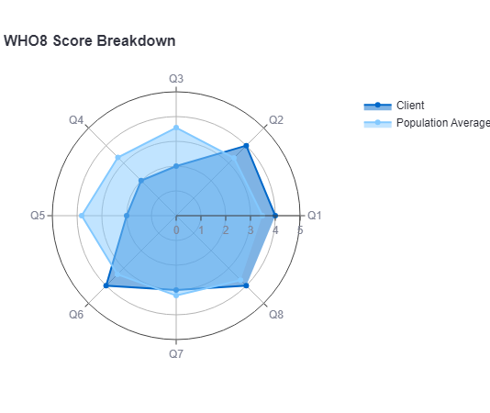
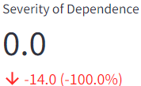
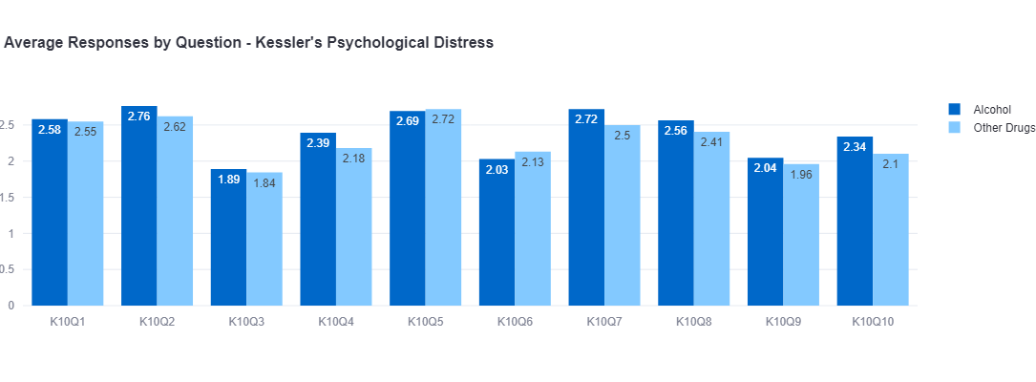
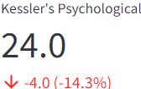
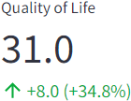
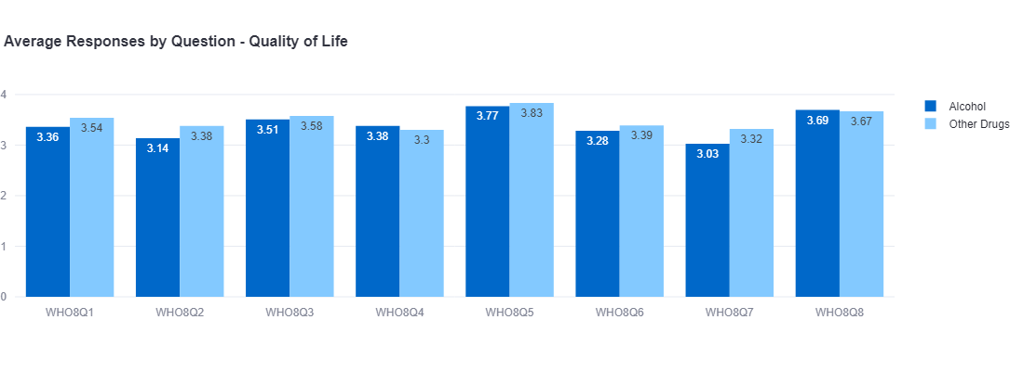
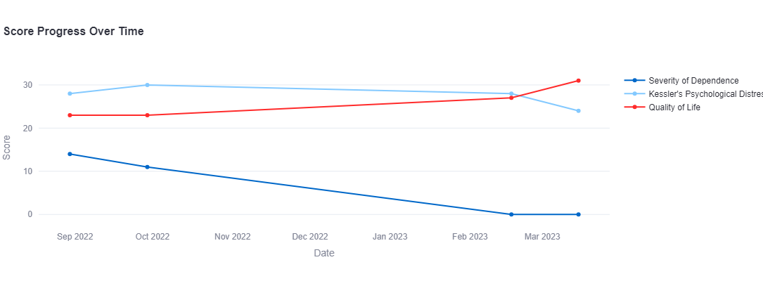
SINGULAR ALCOHOL OR CLIENT
SAMPLE GRAPHS FOR ALCOHOL
SAMPLE GRAPHS FOR 1 CLIENT
Notes:
Average Responses by question: Scores for alcohol cases generally higher than for other drugs on questions like K10Q2, K1007, and K10Q8
➔ alcohol-using clients experience more psychological distress than those with other drug dependencies.
WHO8 Score Breakdown: The client's quality of life appears to be consistently lower than the average of all clients, potentially indicating that this client may benefit from more personalized interventions to address specific areas of well-being.
Severity of Dependence: A reduction by 14 points (-100%) suggests that the client may no longer feel dependent on alcohol , significant progress. (the score should show green instead of red)
Kessler’s Psychological Distress: A decrease of 14 points (-14.3%) implies reduced distress, which is a positive outcome. (the score should show green instead of red)
Quality of Life: An increase of 8 points (+34.8%) suggests that the client’s perceived quality of life has improved significantly.

